Slide 1
So, What’s My Marketing Strategy?

Slide 2
Five TARGETED Strategies I Use To Market Your Home:
Google & Social Media Placement

Slide 3
Consider this scenario; you sit down with a potential seller and show them their home along with this data:

Slide 4
140 monthly searches at a $600,000 average sale price!

Slide 5
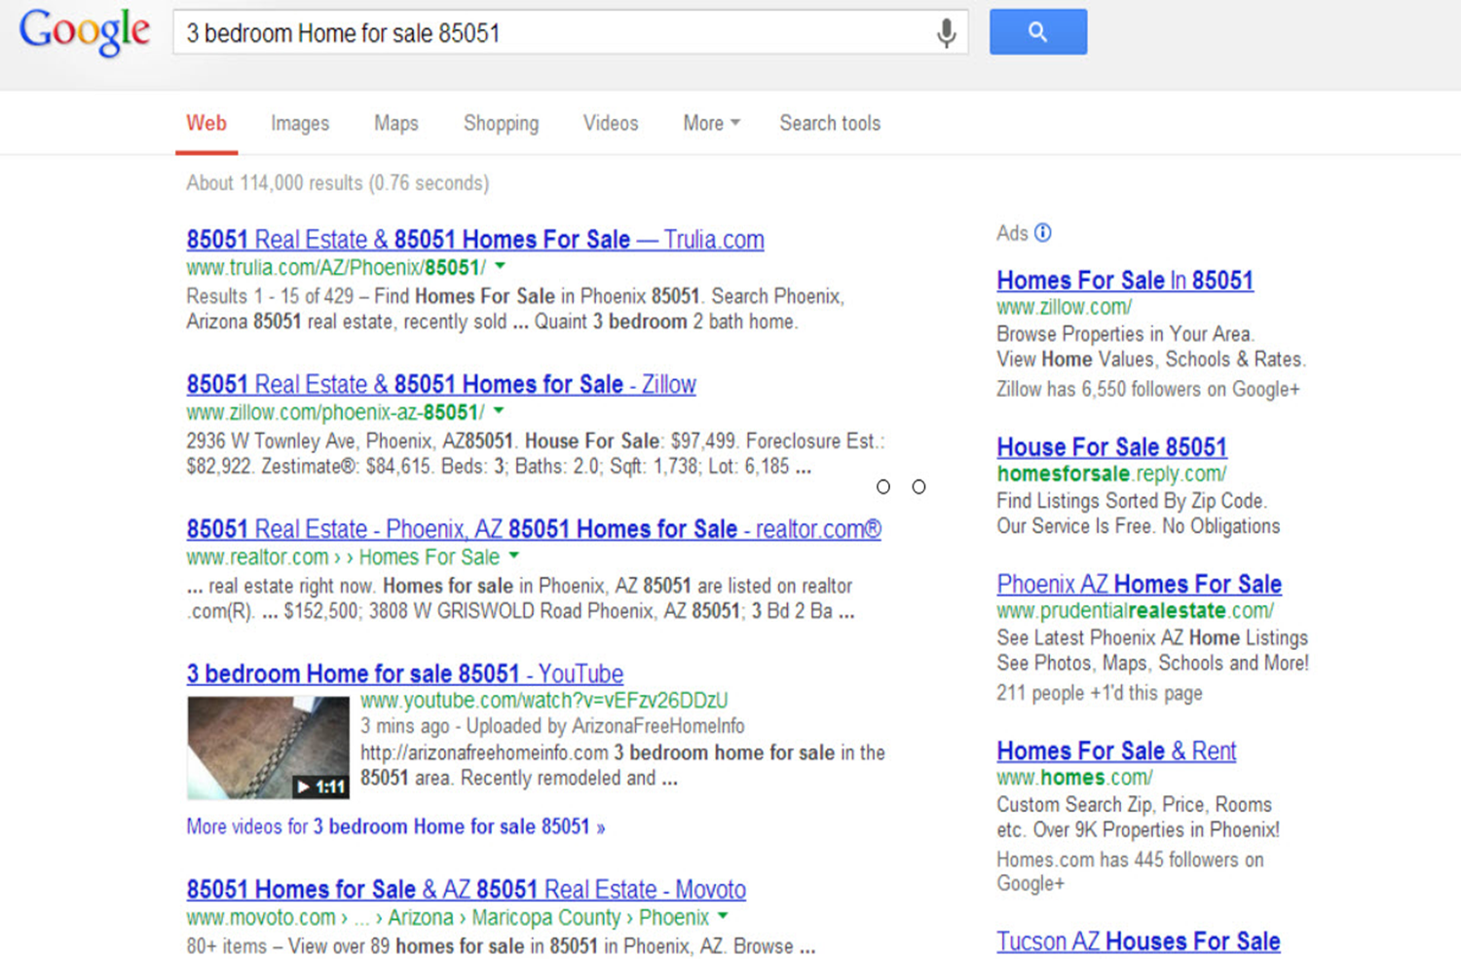
Show Them Their House On Page #1 of Google
87%

Slide 6
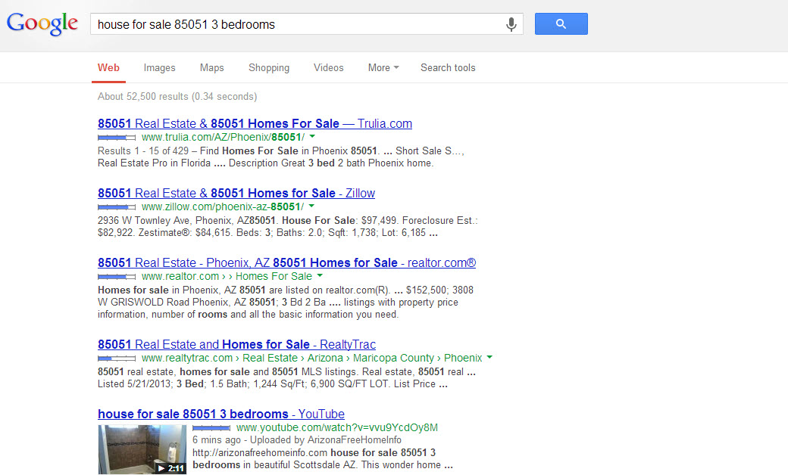
Show Them Their House On Page #1 of Google
87%

Slide 7
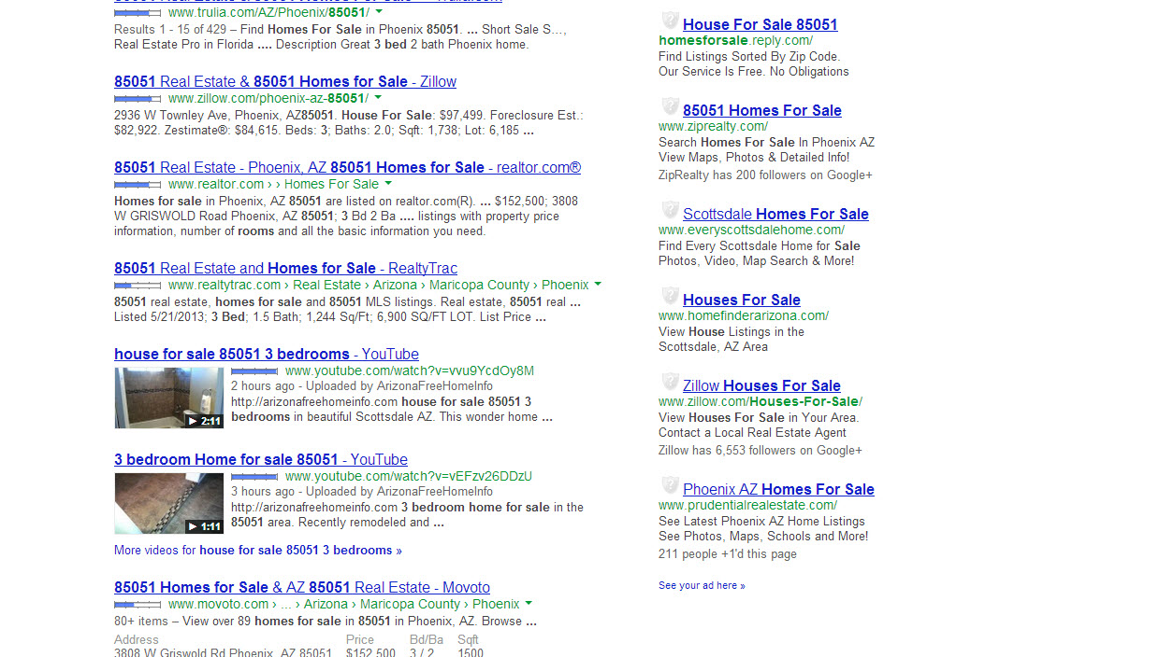
Show Them Their House On Page #1 of Google
87%

Slide 8
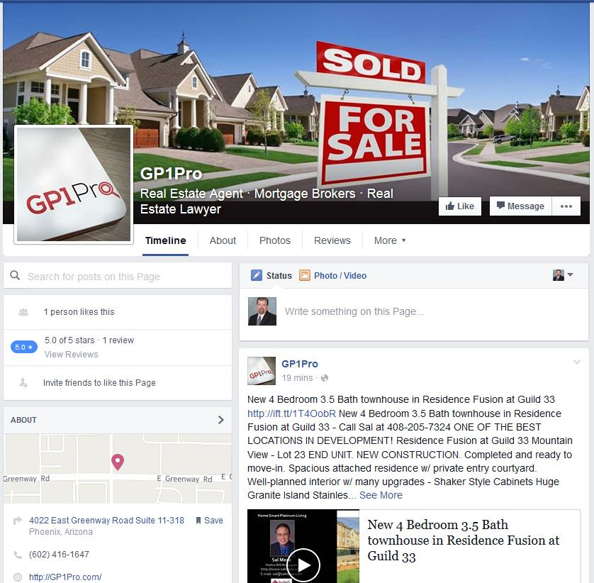
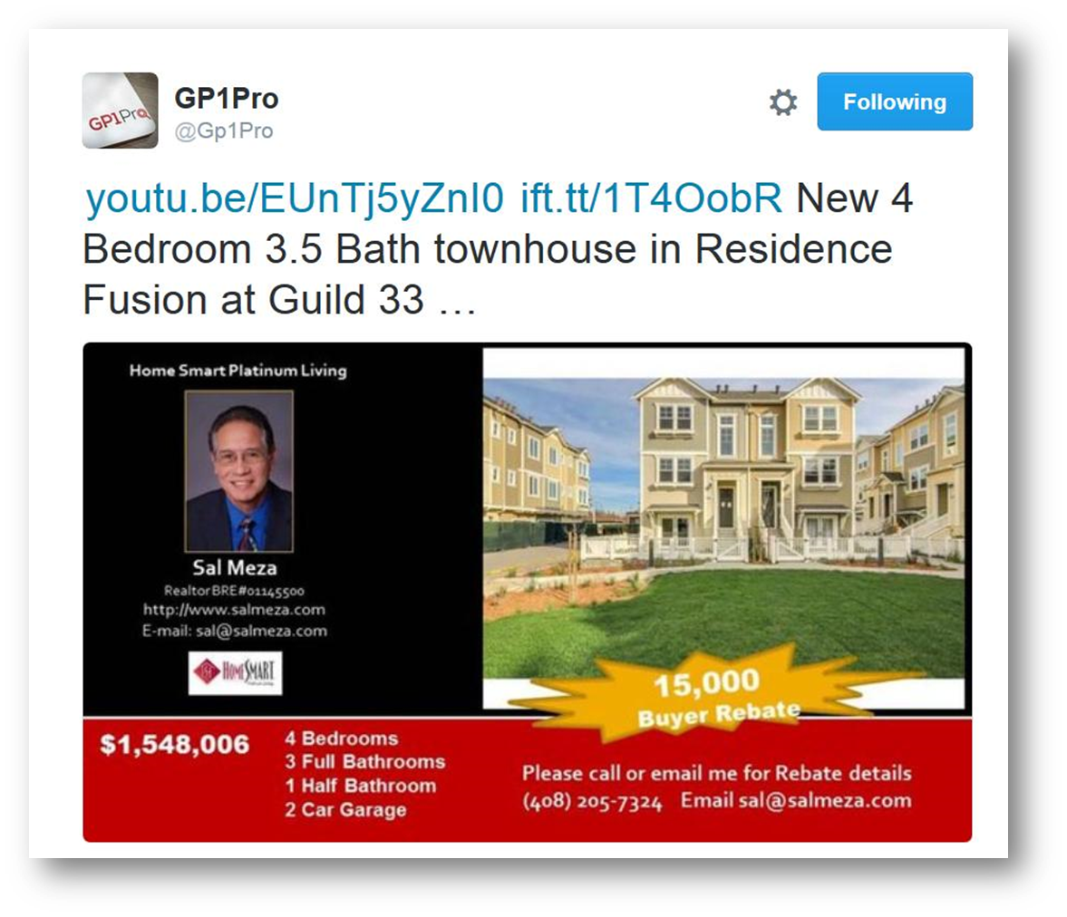
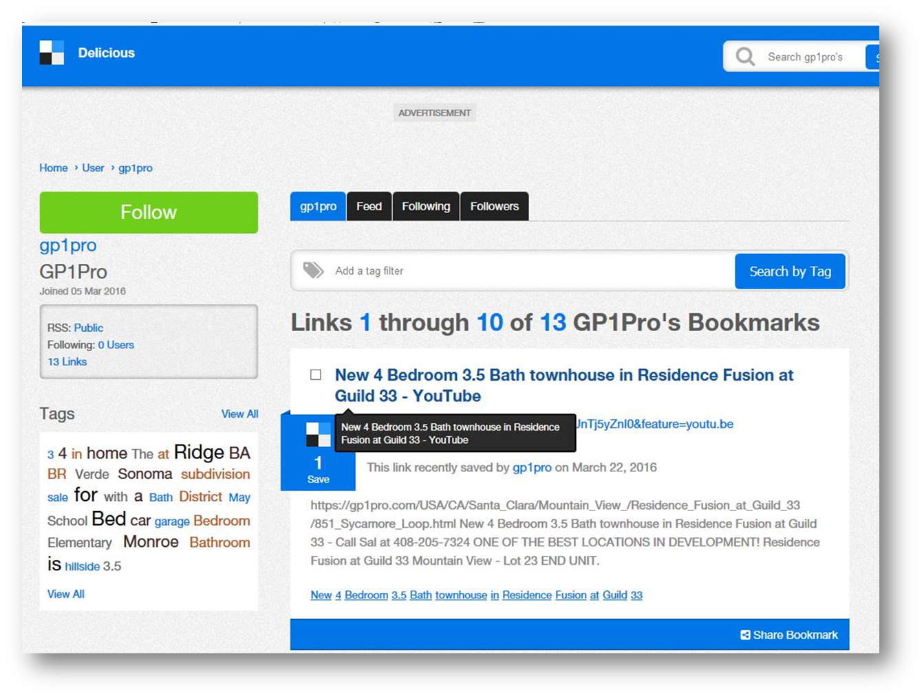
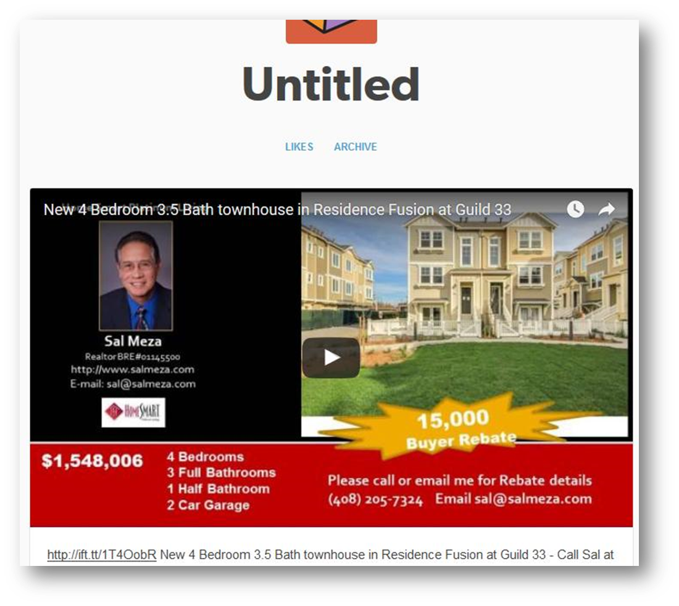
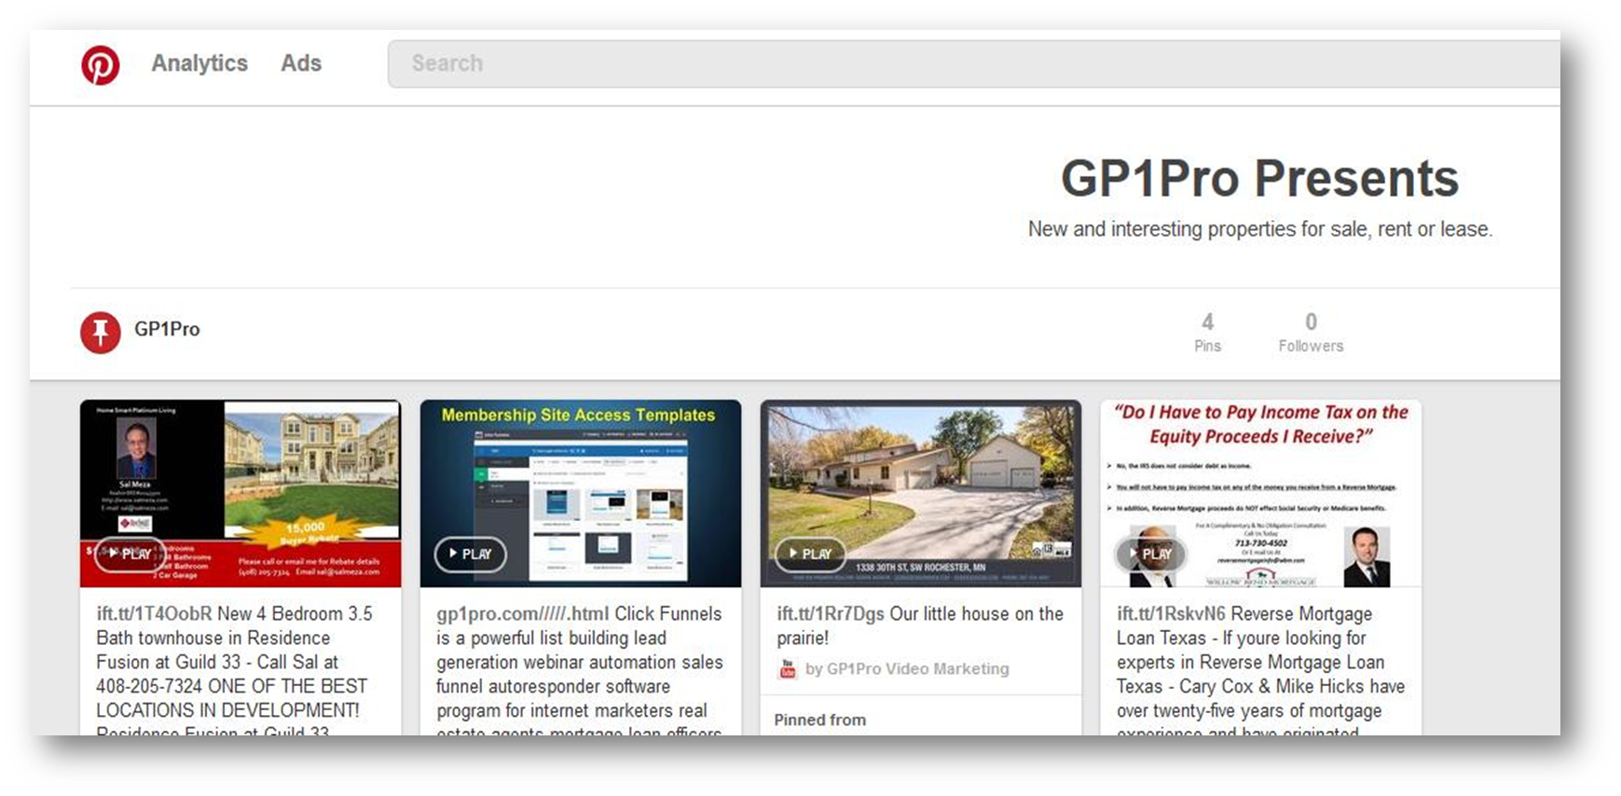
And, their home is also posted on Social Media…

Slide 9
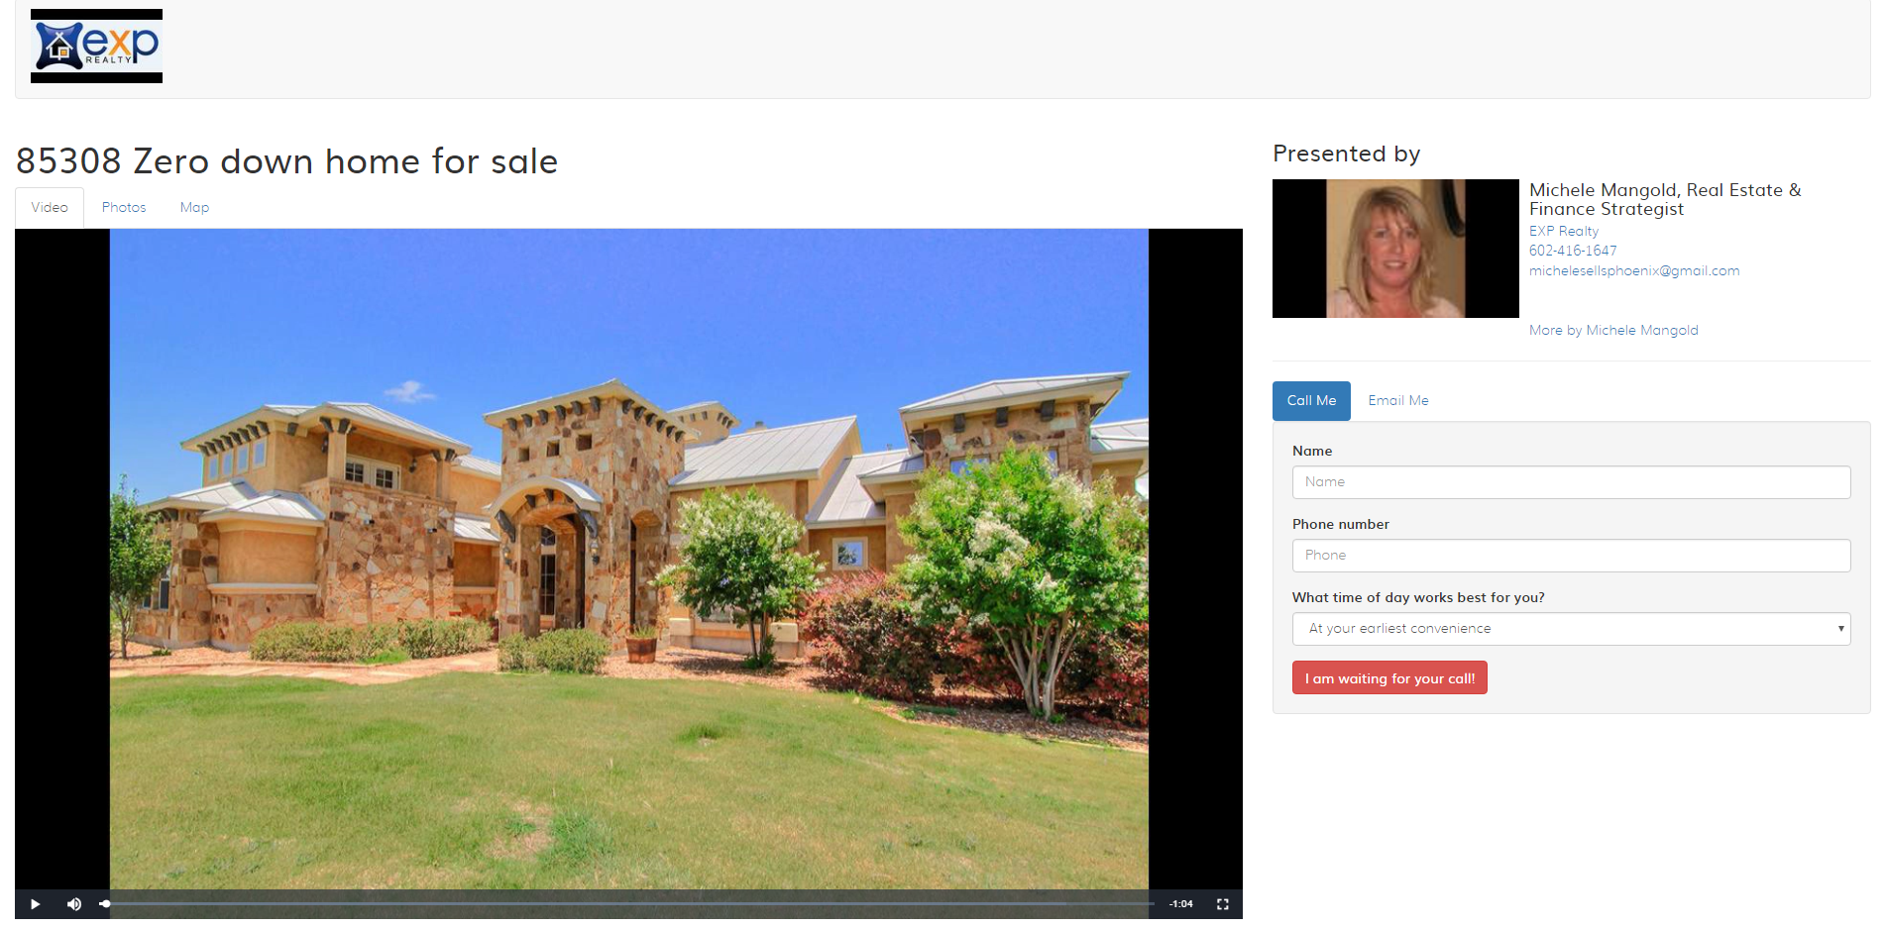
Single Property Video Web Sites Created:

Slide 10
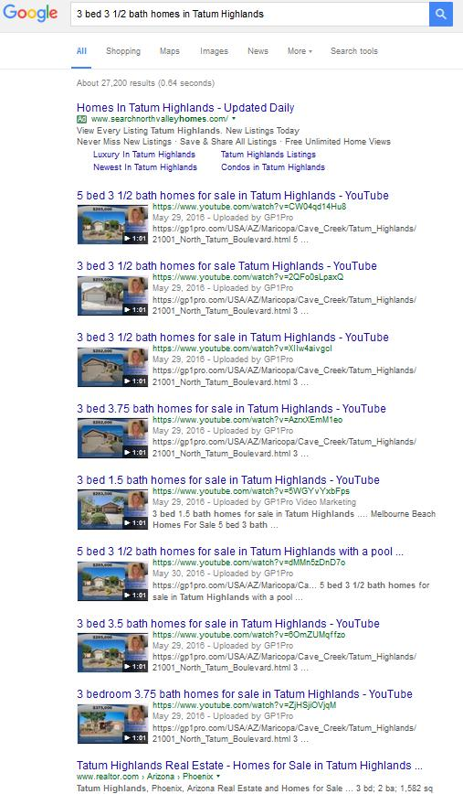
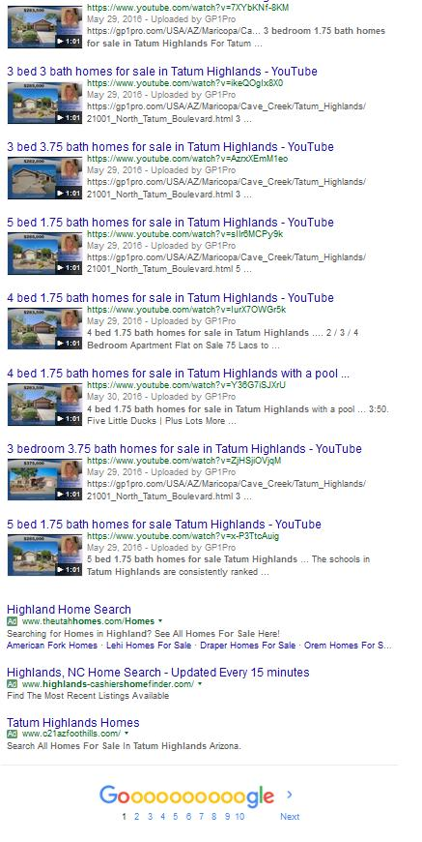
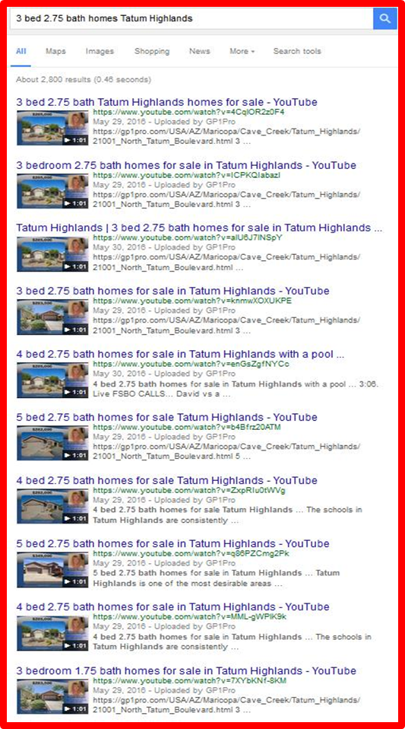
And, What If You DOMINATED Their Subdivision Like This?

Slide 11
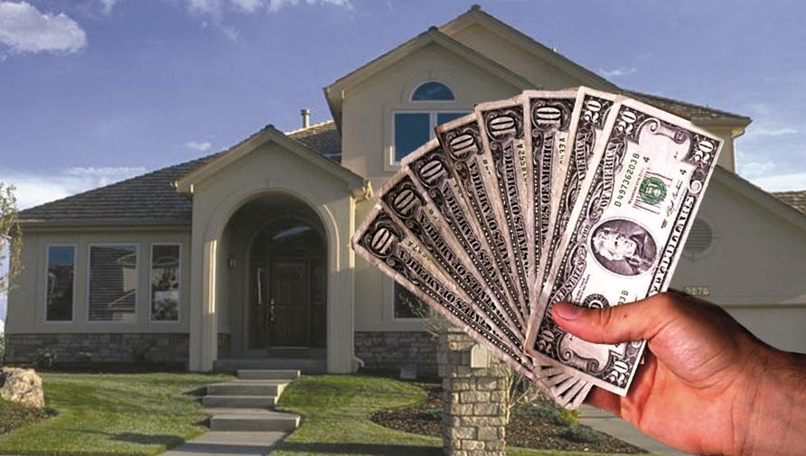
Five TARGETED Strategies I Use To Market Your Home:
Google & Social Media Placement
Positioning - Financing

Slide 12
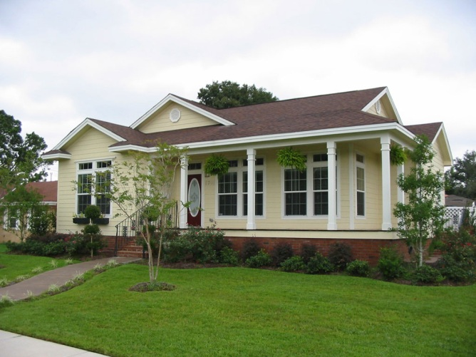
POSITIONING:
Which Home Would You Call On?
Save $53,272
Text SAVE to 70734

Slide 13
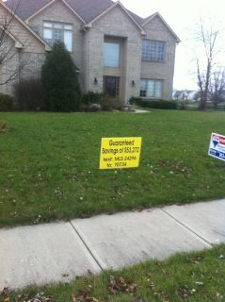
Financing Strategy:

Slide 14
I use Rider Signs like these:
Save $96,312 In Payments On This Home
Text 96312 to 71441 for Special Mortgage Offer!
Take a 24 Hour Virtual Tour Of This Home:
Text MLS1000 to 71441

Slide 15
Five TARGETED Strategies I Use To Market Your Home:
Google & Social Media Placement
Positioning - Financing
Facebook Systems

Slide 16
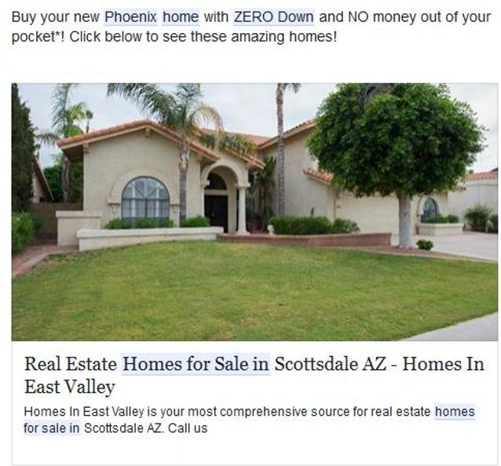
Facebook Ads Targeting Renters & Move Up Buyers:

Slide 17
Five TARGETED Strategies I Use To Market Your Home:
Google & Social Media Placement
Positioning - Financing
Facebook Systems
Craigslist Strategy

Slide 18
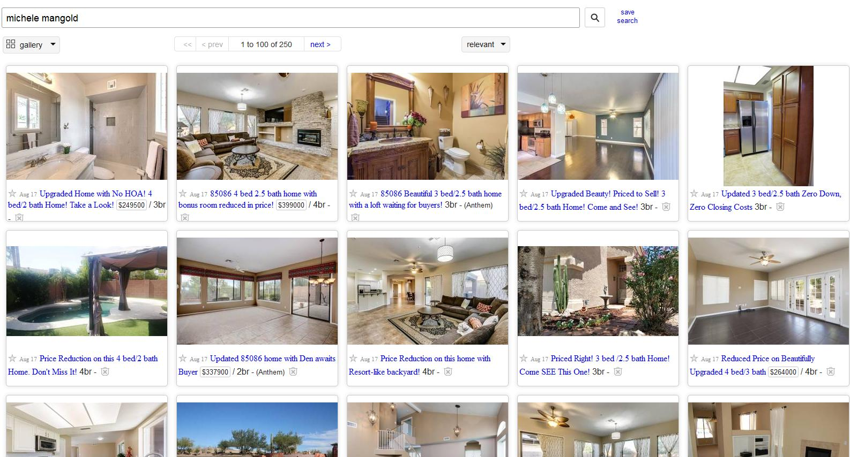
Craigslist Marketing:

Slide 19
Five TARGETED Strategies I Use To Market Your Home:
Google & Social Media Placement
Positioning - Financing
Facebook Systems
Craigslist Strategy
SMS Text Strategy

Slide 20
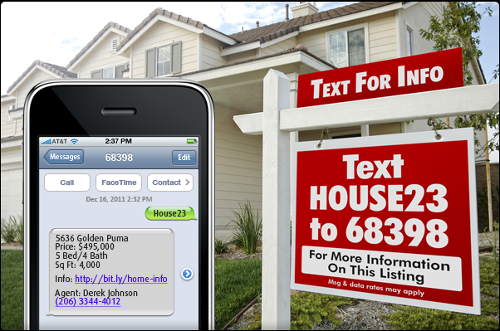
Text Marketing:

Slide 21
I use Rider Signs like these:
Take a 24 Hour Virtual Tour Of This Home:
Text MLS1000 to 71441

Slide 23
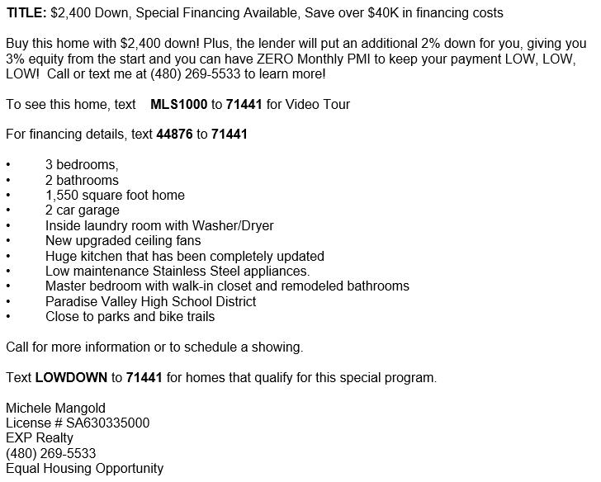
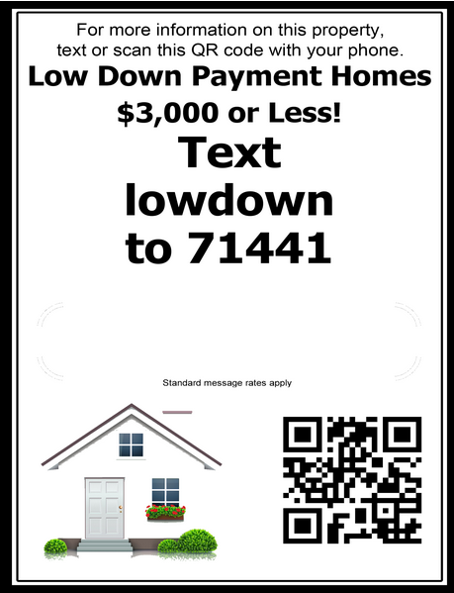
Your Craigslist Ad:

Slide 24
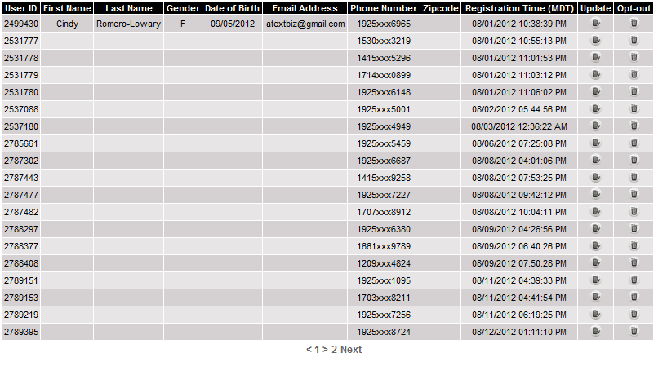
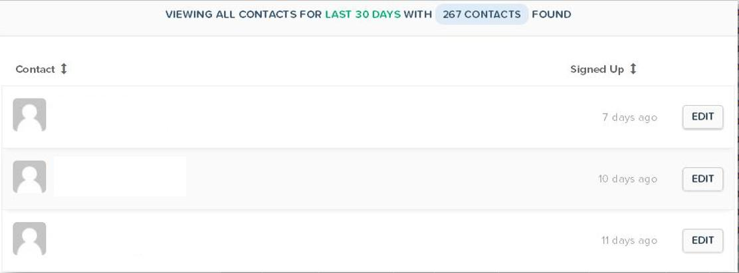
My Database Of Current Buyers:

Slide 25
Open House Systems If You Want To Implement:

Slide 26
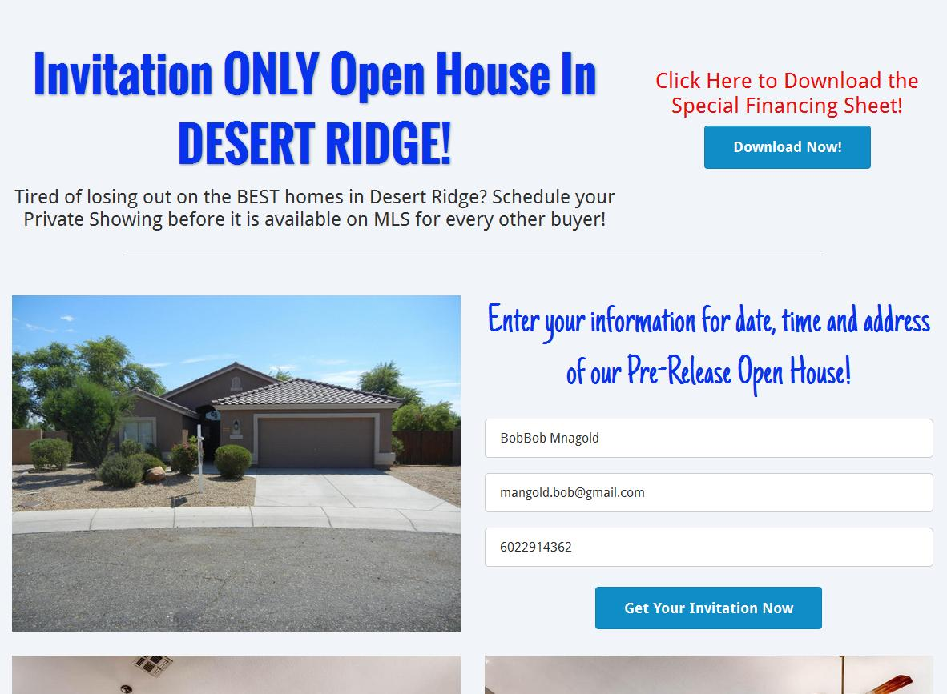
Facebook Open House System

Slide 27
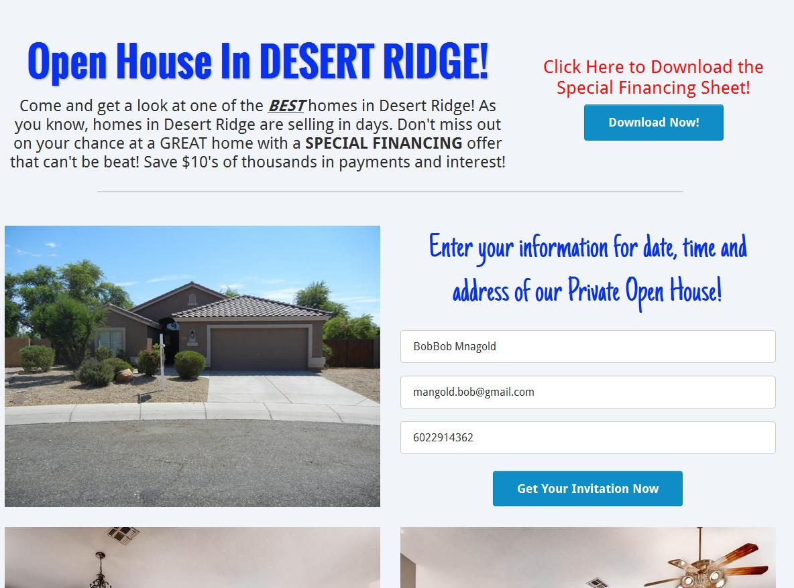
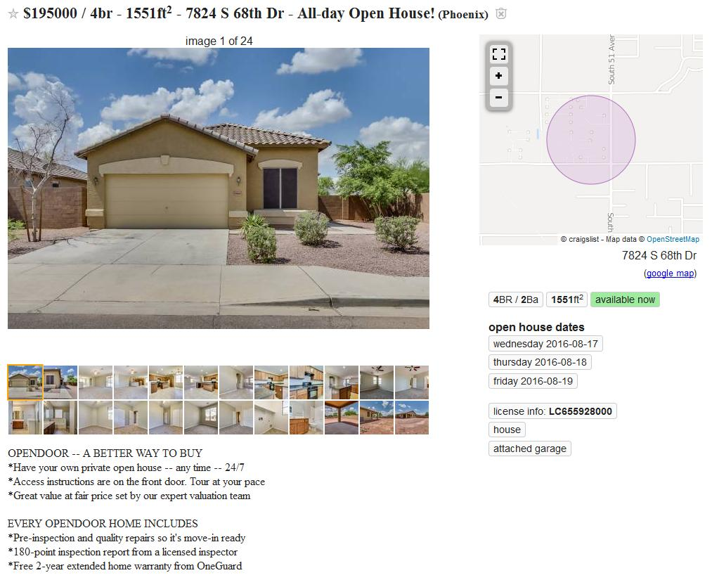
Craigslist Open House System:

Slide 28
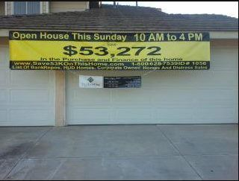
What Would Happen If You Used This Sign For An Open House?

